Slide 1



J K K NATTRAJA COLLEGE OF ENGINEERING AND TECHNOLOGY
Mentor:
MURUGASHANKAR S AP/IT
Domain :
Applied Data Science
Title:
Predicting IMDB Scores
Team Members:
A.PRAGALANATHAN
M.PAISAL RAHUMAN
M.GOWTHAM
S.KARTHIK
S.DHILIP SANJAY

Slide 2
Abstraction:
Predicting Internet Movie Database (IMDb) scores for movies or TV shows based on content is a complex task that involves analyzing various elements of the content itself, as well as external factors. IMDb scores are determined by user ratings and reviews, making them subjective and influenced by a multitude of factors. Here is a condensed overview of key considerations when predicting IMDb scores based on content

Slide 3

Description:
IMDb is a popular website that provides information about movies, TV shows, actors, directors, and other aspects of the entertainment industry. It offers details like cast and crew, plot summaries, user ratings, reviews, and more, making it a go-to resource for movie enthusiasts and industry professionals.
C.

Slide 4
Objectives:
Predicting IMDb scores aims to estiPredicting IMDb scores aims to estimate a movie's rating using machine learning. Steps involve data collection, preprocessing, model selection (e.g., regression), feature engineering, and model training. Model evaluation metrics like MSE and RMSE gauge accuracy. Continuous monitoring and adaptation are crucial due to evolving audience preferences.

Slide 5
About Project:
source:
Predicting IMDB scores from kaggle
Data Sets:
In this process we perform a load the data into pandas and preprocessing then other actions

Slide 6
Data preprocessing:
Handling Missing Data:
●Check for missing data in the dataset and decide how to handle it. You may impute missing values with reasonable estimates or remove rows with missing data
Handling Imbalanced Data:
●If you have imbalanced IMDb score categories (e.g., too many high or low scores), consider techniques like oversampling or undersampling to balance the dataset

Slide 7
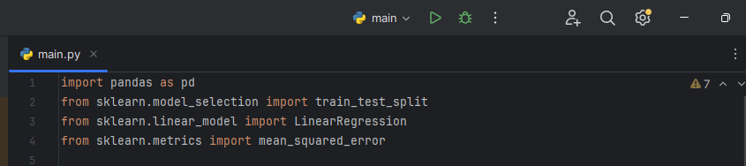
Code:
Importing pandas and loading the dataset

Slide 8
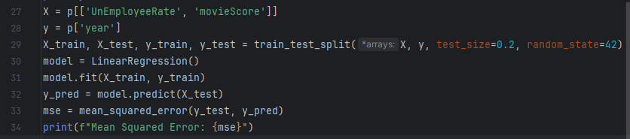
Code:
Preprocessing the data and analysis

Slide 9
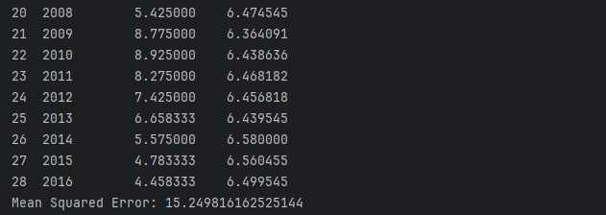
output:

Slide 10
Importing packages and code:

Slide 11
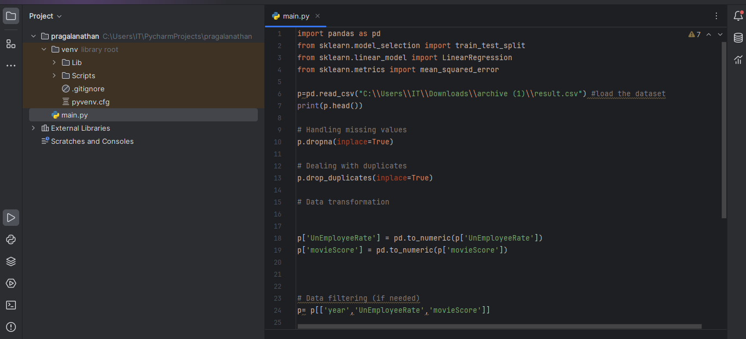
Whole code i:

Slide 12
whole code ii:

Slide 13
THANK YOU!!!

